Slide 1
Outline
Introduction
Related work
Methodology
Experiments

Slide 2
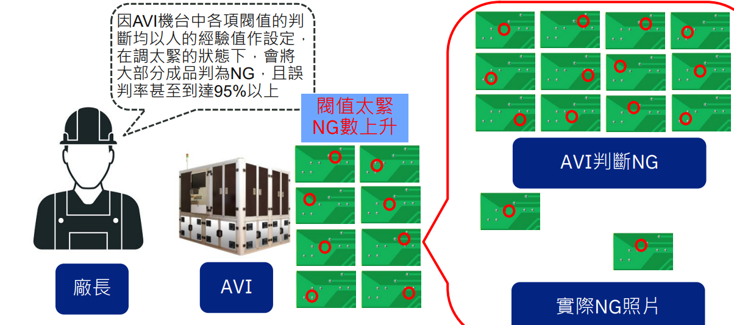
Introduction
Traditional AOI machine high overkill

Slide 3
Introduction
Defect image is rare
🞑 2023 Week 45 data type distribution

Slide 4
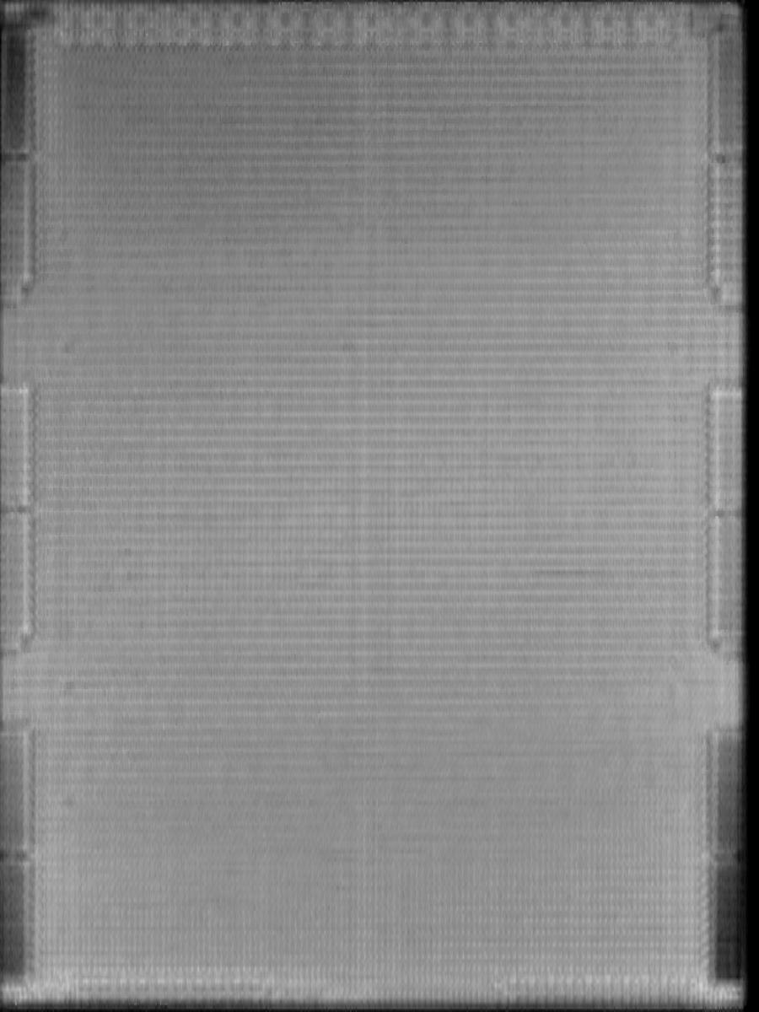
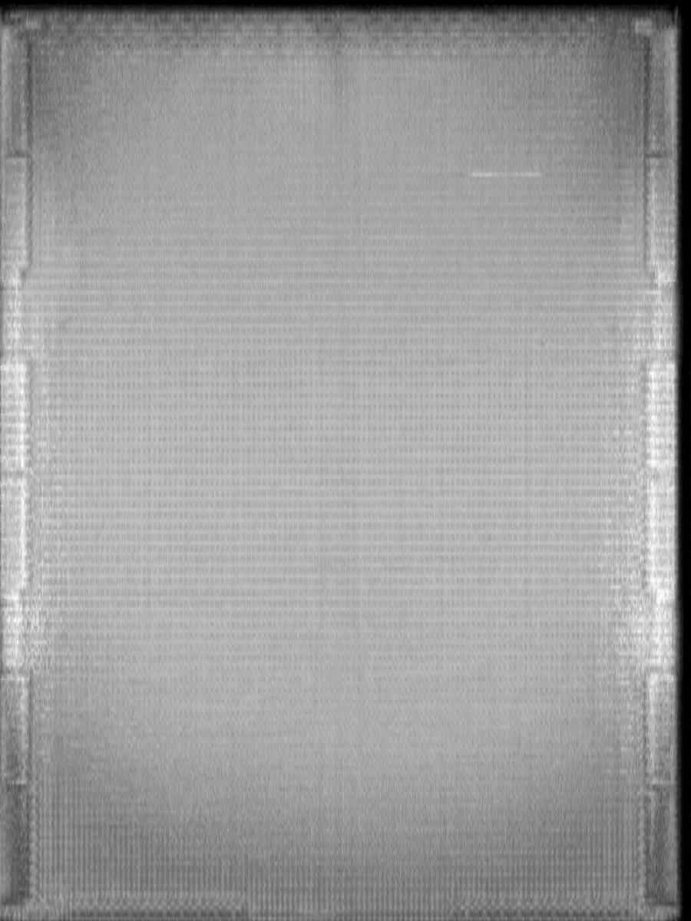
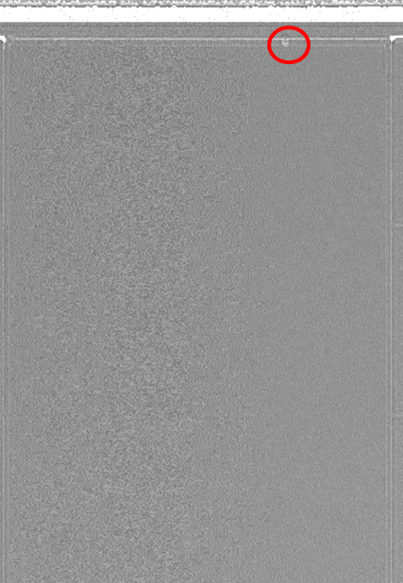
Introduction
SAT(AOI machine) image
Pass image Defect type A image Defect type B image

Slide 5
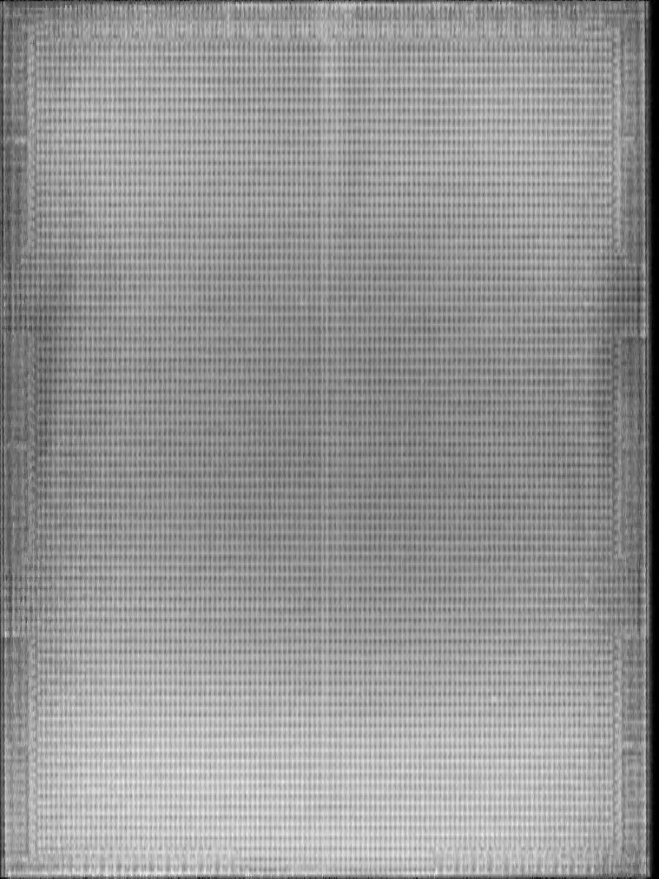
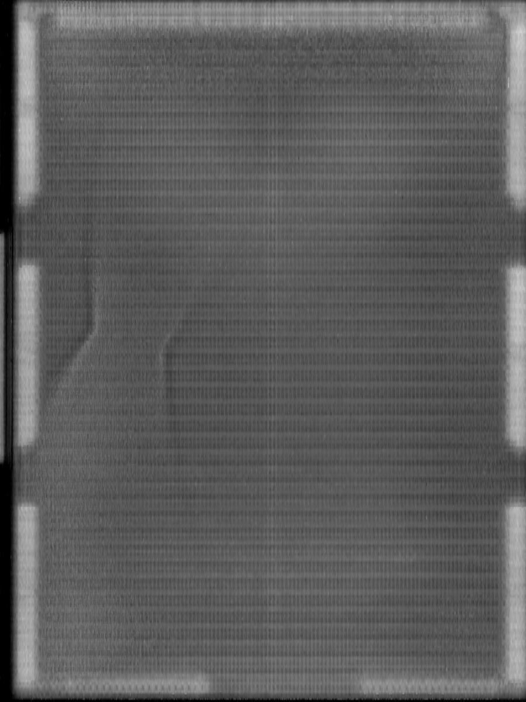
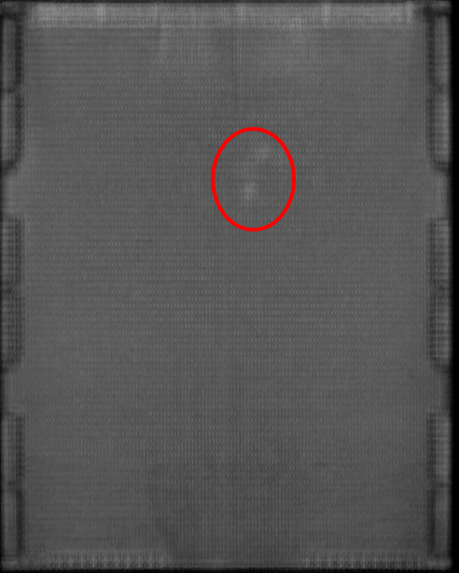
Introduction
SAT(AOI machine) image
Defect type C image Defect type D image Defect type E image

Slide 6
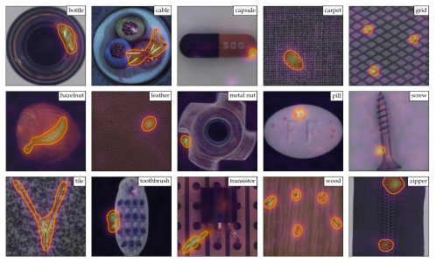
Related work
A Towards Total Recall in Industrial Anomaly Detection
Karsten Roth , Latha Pemula , Joaquin Zepeda , Bernhard Scholkopf , Thomas Brox
University of Tubingen , Amazon AWS arXiv:2106.08265
🞑 In this work ,It arises in many industrial scenarios where it is easy to acquire
imagery of normal examples but costly and complicated to specify the expected
defect variations in full
Patchcore in MVTec dataset segmentation result

Slide 7
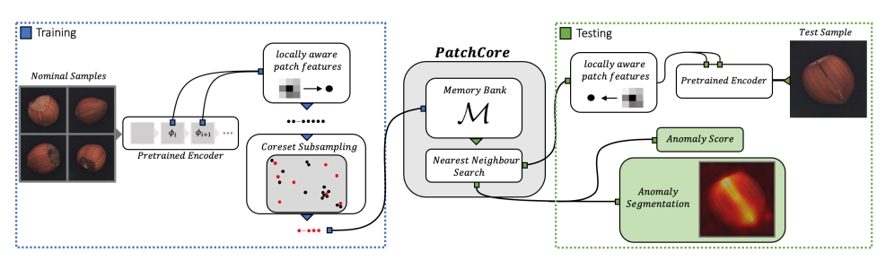
Related work (method)
A Towards Total Recall in Industrial Anomaly Detection
🞑 The PatchCore method consists of several parts that we will describe in sequence
local patch features aggregated into a memory bank a coreset-reduction method
to increase efficiency and finally the full algorithm that arrives at detection and
localization decisions.

Slide 8
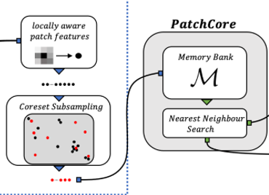
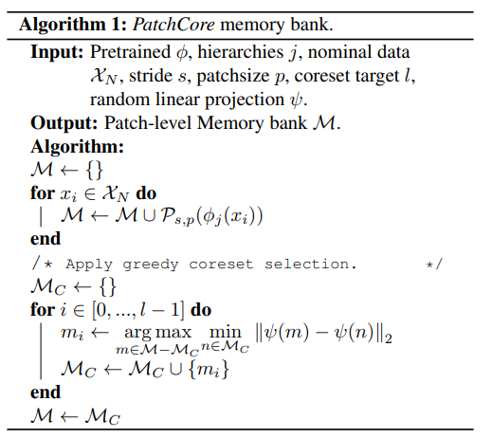
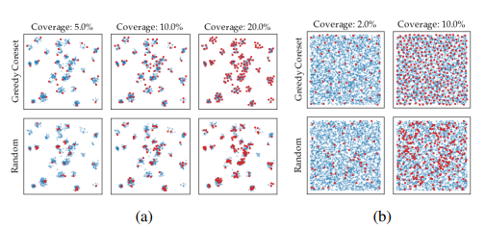
Related work (method)
Greedy coreset selection algorithm

Slide 9
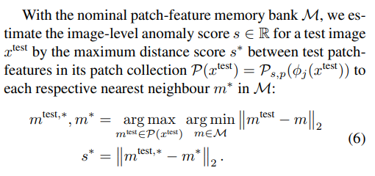
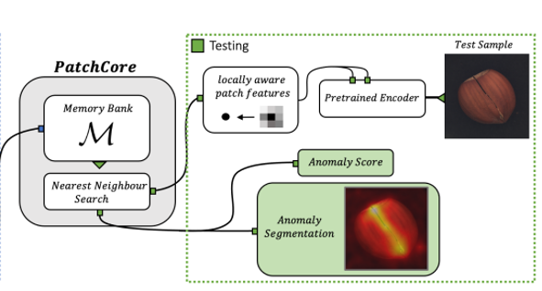
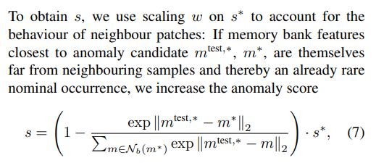
Related work (method)
Inference stage anomaly detection

Slide 10
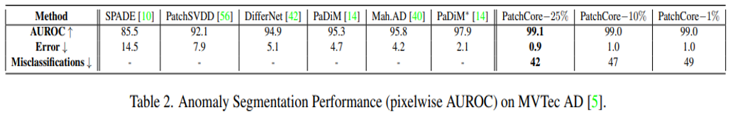
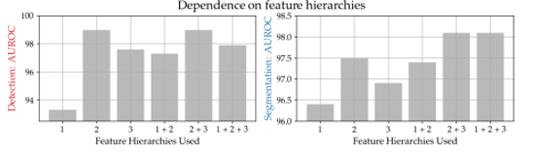
Related work (method)
Experiments

Slide 11
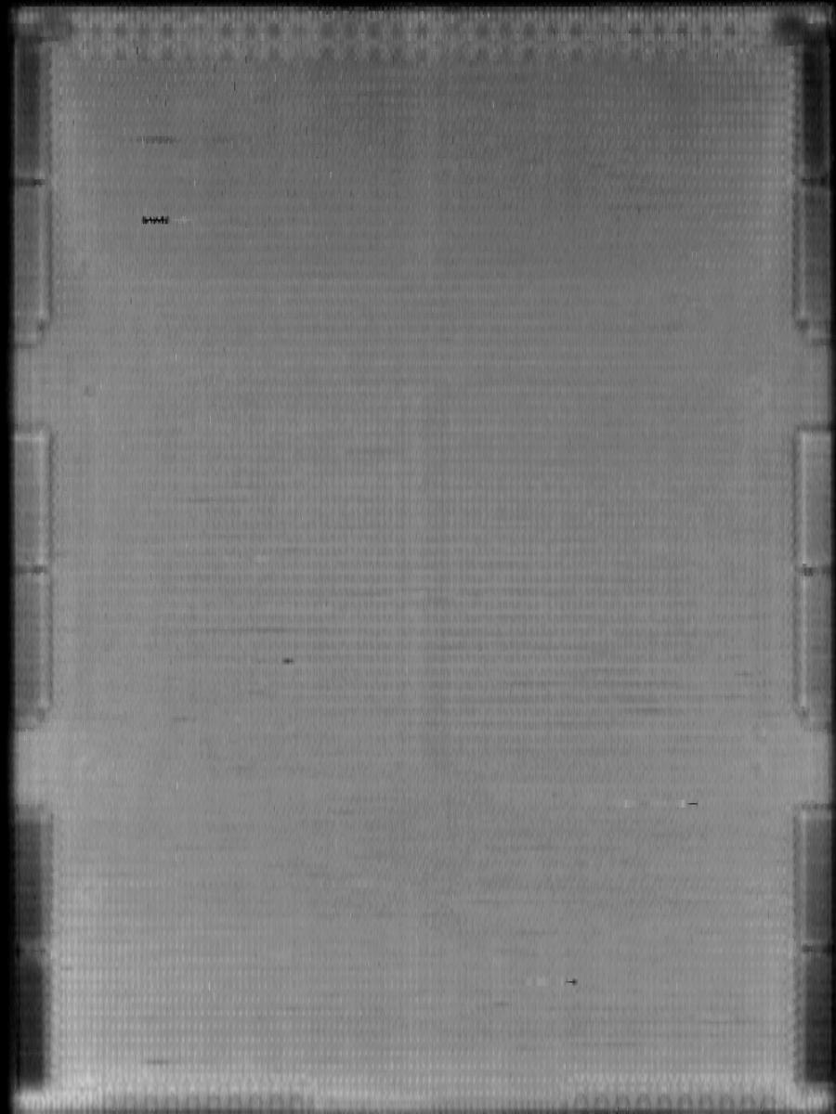
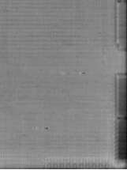
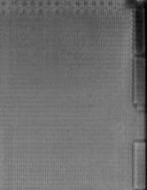
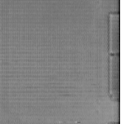
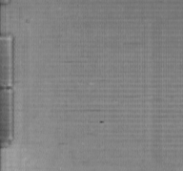
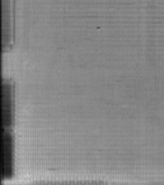
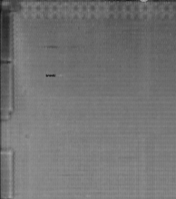
Related work (method)
Image Preprocess
Image size = 900x1200
Image size = 224x224
1
2
Divide to 6 patch(600x600)
And Resize to (224x224)
3
4
5
6

Slide 12
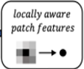
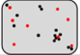
Related work (method)
Training stage
Image size = 224x224
Subsampling
Pretrain encoder
(28x28x512)
Adaptive pooling
(7x7x512)
Extract 10% feature
Patchcore
Pretrain model structure : res2net+transformer
Pretrain method : BYOL (self-supervise) Bootstrap your own latent
Pretrain dataset : Our product data (30M)
Parameter num : 12M
Memory
bank

Slide 13
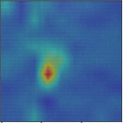
Related work (method)
Testing stage
Image size = 224x224
Patchcore
Memory
bank
Pretrain encoder
(28x28x512)
Adaptive pooling
(7x7x512)
Nearest neighbor
Search
Anomaly score
Pretrain model structure : res2net+transformer
Pretrain method : BYOL (self-supervise) Bootstrap your own latent
Pretrain dataset : Our product data (30M)
Parameter num : 12M
Anomaly
segmentation

Slide 14
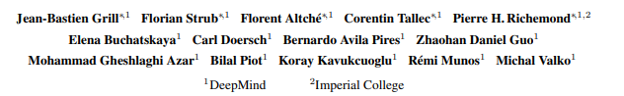
Related work (method)
Pretrain method
Bootstrap Your Own Latent A New Approach to
Self-Supervised Learning
🞑 In this paper, we introduce Bootstrap Your Own Latent (BYOL), a new algorithm
for self-supervised learning of image representations.
BYOL achieves higher performance than state-of-the-art contrastive methods
without using negative pairs

Slide 15
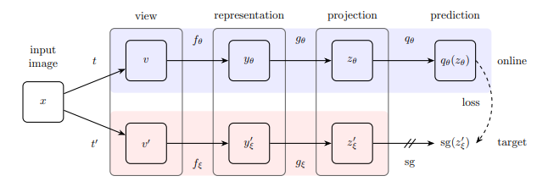
Related work (method)
Pretrain method
上半部為正常照片擷取特徵路徑
下半部為正常照片做augmentation後做擷取特徵路徑
🞑 BYOL’s architecture. BYOL minimizes a similarity loss between qθ(zθ) and sg(z 0 ξ )
where θ are the trained weights, ξ are an exponential moving average
of θ and sg means stop-gradient.
Our v (model architecture) in next page

Slide 16
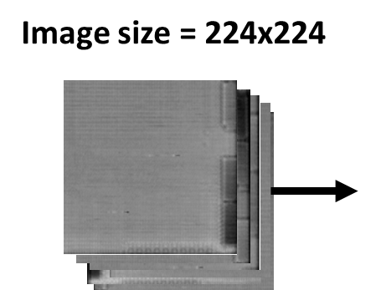
Related work (method)
Model architecture
112x112x64
56x56x64
28x28x256
Convolution
Kernel size = 7
Strides = 2
Output ch = 64
Max-pooling
Kernel size = 3
Strides = 2
Res2net block
Strides = 2
Block num = 2
Output ch = 256
Global average pooling
Strides = 14
Kernel size = 14
Cvt transformer block
Strides = 1
Block num = 4
Output ch = 1024
Res2net block
Strides = 2
Block num = 4
Output ch = 512
1x1x1024
(BYOL represent)
14x14x1024
(BYOL view)
14x14x512

Slide 17
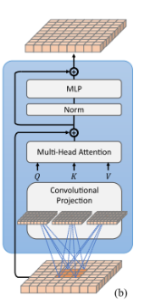
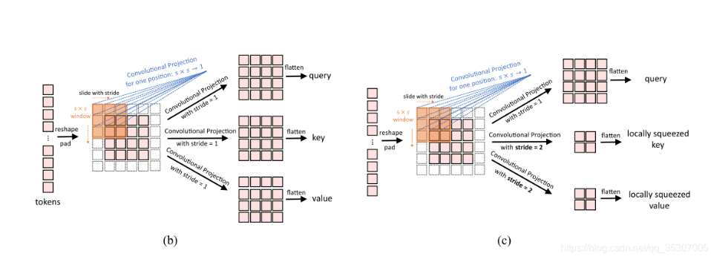
Related work (method)
Model architecture (Cvt transformer block)
arXiv:2103.15808

Slide 18
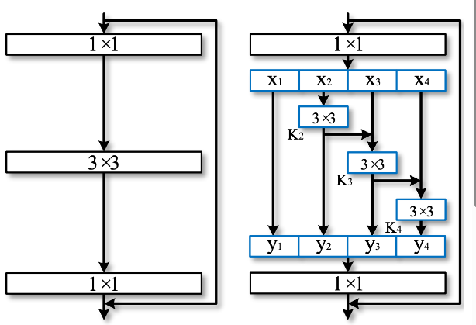
Related work (method)
Model architecture (Res2net block)
arXiv:1904.01169
Resnet block Res2net block

Slide 19
Related work (method)
Pretrain method
Global average pooling
Strides = 14
Kernel size = 14
Hidden layer
Output ch = 256
Hidden layer
Output ch = 256
1x1x1024
(BYOL represent)
256
(BYOL projection)
256
(BYOL predictor)
Global average pooling
Strides = 14
Kernel size = 14
Hidden layer
Output ch = 256
1x1x1024
(BYOL represent)
256
(BYOL projection)

Slide 20
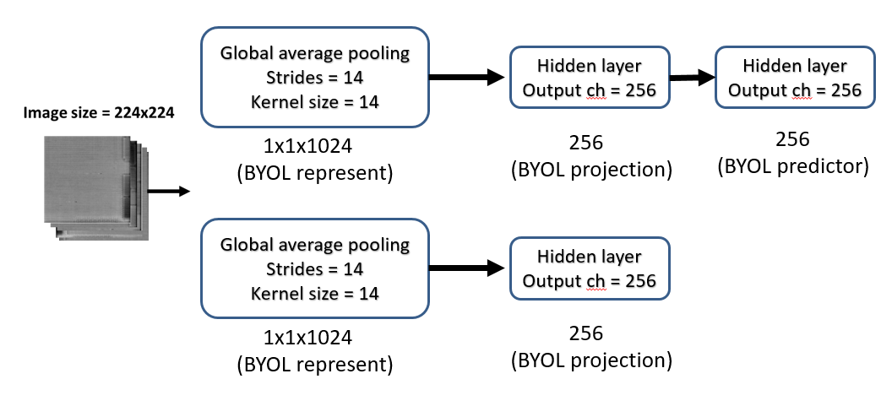
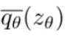
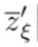
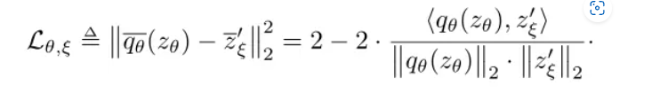
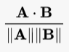

Related work (method)
Pretrain method
Cosine similarity
LOSS
越相似算出來越接近1

Slide 21
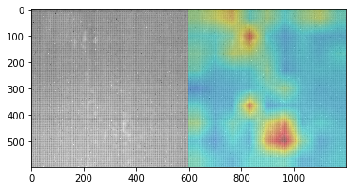
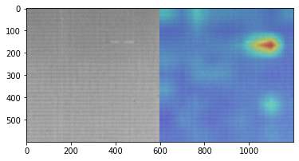
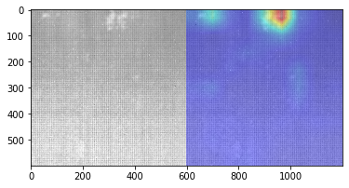
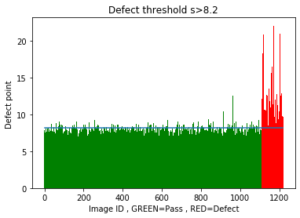
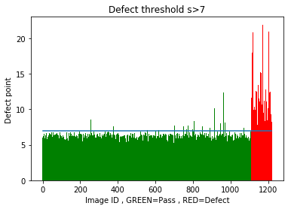
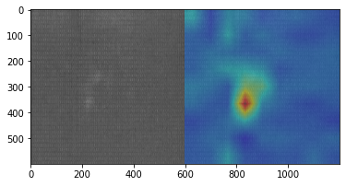
EXPERIMENTS
Patchcore 1%
Patchcore 25%

Slide 22
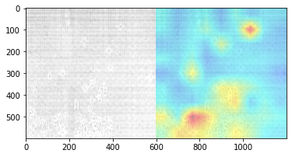
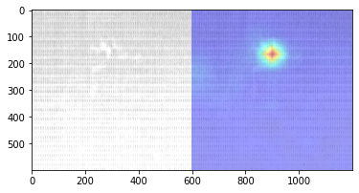
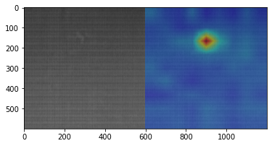
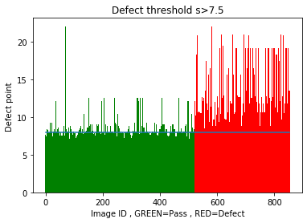
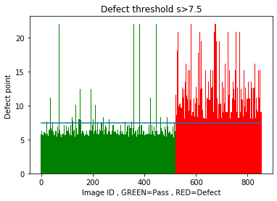
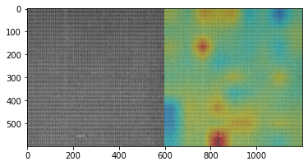
EXPERIMENTS
Patchcore 1%
Patchcore 25%

